Slide 1

OSLO Core Consent
Welcome! We will start at 1:05 pm.
Thursday the 23th of September 2021
Virtual Workshop - Microsoft Teams
Digitaal Vlaanderen

Slide 2

Purpose of today
Summary context & Business workgroup
Presentation of collected use cases
Presentation & brainstorming of the draft model
Going over the existing standards

Slide 3



Practicalities
Sound of the audience is muted by default.
Use the hand if you want to say something. Interaction is encouraged!
Questions, comments and suggestions can be communicated via the chat function. Interaction is encouraged!
Yes/No questions can be answered via the chat:
Agree = +1
Disagree = - 1
Indifferent = 0

Slide 4

Recording?

Slide 5


Agenda
Welcome: Who is who 5 min
The reason for this trajectory 10 min
Summary of the previous workshop 10 min
Scoping of core consent 30 min
15 min. break
UML: main concepts 10 min
Discussing the draft model 60 min
Q&A and next steps 10 min

Slide 6
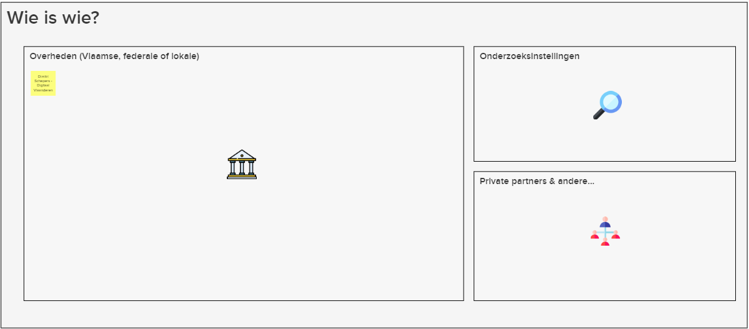

WIP
Who is who?
5’

Slide 7
Rationale for this trajectory and summary of the previous workshop
Digitaal Vlaanderen

Slide 8
What is TRAPEZE?
TRAPEZE is a project, financed by the European Commission, that delivers a platform as a solution for organisations and citizens with some concrete objectives on security and privacy.
It aims to:
Bring stakeholders together under a common framework;
Provide citizens with the necessary tools and know-how to manage their security and privacy;
Supporte consent mechanisms and verifying that data is used appropriately;
Restore citizens' trust in the digital economy by implementing 'log integrity' and 'non-repudiation';
Build up 'data lineage' and 'transparency by design' and
Illustrate its usefulness by applicing it in 3 domains, namely government, telecom and financial sector.

Slide 9
What is expected?
Common data standard for “consent”
The objective of this project is to manage the consent of an agent’s data exchange in a uniform, standardised and machine-interpretable manner.
2-part objective, namely:
OSLO trajectory
Application profile for a wide range of use cases, i.e.:
As a citizen
As a business party using a permission
Use cases relating to delegation of consent
Co-creative trajectory for the development of an unequivocal data standard concerning core consent.
Involving the main stakeholders (federal and regional authorities, local authorities, private organisations) in order to develop a data standard that is supported as broadly as possible

Slide 10
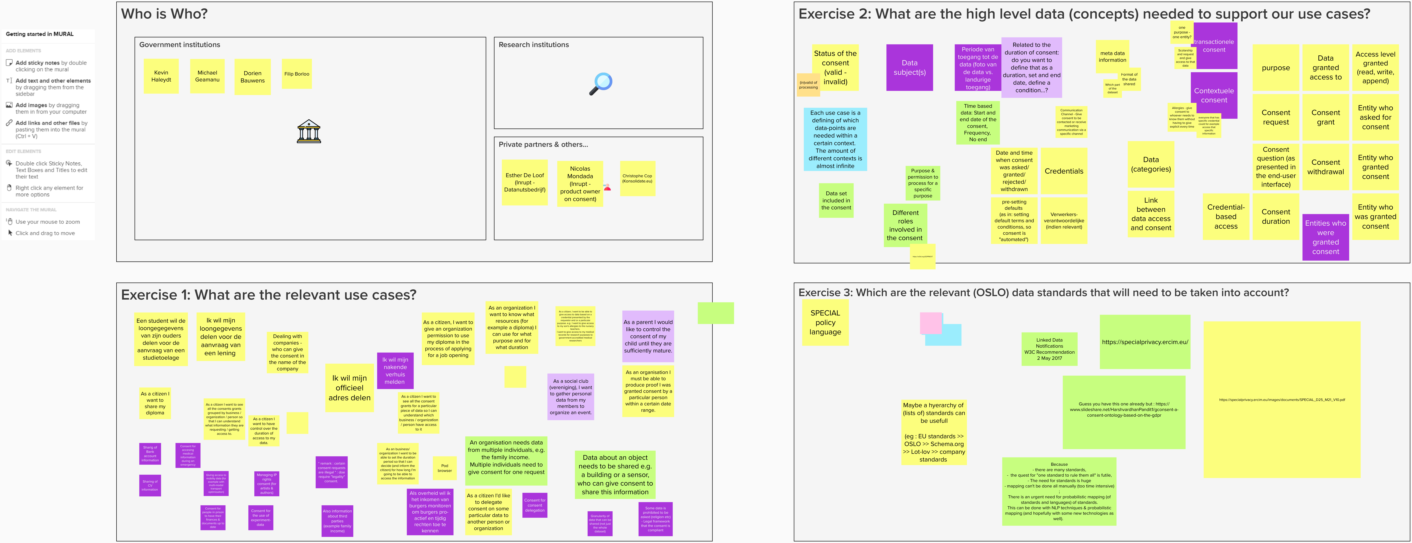


What did we do in the previous workshop?
OSLO introduction
Scope, context discussing use cases
Brainstorm session
Levels of interoperability
Semantic
Technical
Re-use of data(standards)
Process and method
Context of the workshops
What do we mean with “Core consent”?
Which use cases are applicable?
What data do we need to realise those use cases?
Use cases
Data concepts
Relevant standards
...

Slide 11
Exercise 1: What are the relevant use cases?
Use case | Priority
Person X wants to share data Y with a certain entity. | 10
Person X wants to have the right to give consent for sharing data of another person, company or object. | 5
Everyone should be able to consult all the consents they have granted. | 3
Obtain useful insights due to the consent to access useful data of datasubjects. | 1
Legal framework to be set up, so that the asked consent is compliant with legislation. | 1

Slide 12
Exercise 2: What are the data (concepts) needed to support our use cases?
Characteristics for the consent use cases have been determined. Examples are the period of consent, purpose, party giving and requesting the consent… An important topic here is the type of consent: transactional (one transaction of data) or contextual (in which consent is based on the credentials of the receiver or the situation). Another categorisation is the difference between static (in which a snapshot of data is shared) and dynamic consent (in which a person receives consent to access the live data).

Slide 13
Excercise 3: Which are the relevant data standards that should be taken into account?

Slide 14
How does the planning look like?
OSLO-traject
Start date: 19th of August 2021
Duration: 8 maanden
19th of August
23th of September
21th of October
18th of November
16th of December
January - March
Business workshop
Thematic workshop 1
Thematic workshop 2
Thematic workshop 3
Thematic workshop 4
Implementation of the draft specifications

Slide 15
Scoping of core consent
Digitaal Vlaanderen

Slide 16
What is an use case?
A specific data exchange situation for which the data standard can be used.

Slide 17


Use case 1 – requesting consent
Scope
An agent can give consent to process a certain dataset of him/her, possibly as a response to a request from another agent within a certain context (non-transactional/contextual versus transactional consent.)
The data subject can specify the purpose, access level, access type, time constraints, data granted access to, entity who received consent and the entity who granted consent.
In the case of a request, the data subject has the option to accept it or not.
If a consent has been given, the data subject holds the right to withdraw the consent which was given previously.
Which data do we need?
Credentials of the datasubject
Credentials of the receiver of the data
The data that has been asked for
Formalisation of the consent

Slide 18
Use case 2 – delegation of consent
Scope
An agent holds the right to delegate consent for sharing data to another agent.
To do so, clear boundaries must be defined for the rights of the person giving out the consent.
The relationship between the person giving the consent and the owner of the data must justify the possibility to give out the right and it must be possible to change this right.
Which data do we need?
Credentials of the datasubject and the person giving out the consent
The relationship between the datasubject and the person giving out the consent
The period for which the right is available to someone
A clear demarcation of when the right is applicable and when this is not the case

Slide 19
Use cases – Additional complexities
A data processor can check the integrity and validity of the consent given.
A data processor should be able to produce proof of the consent given.
Consent on shared/co-owned pieces of data (e.g. company information, family income).
Consent on data about objects (e.g. car, building).
Consent for consent delegation.
Granularity of consent.
Legality of requests/consents.

Slide 20

A short break...

Slide 21

Welcome back!

Slide 22
UML: main concepts
Digitaal Vlaanderen

Slide 23
UML: Unified Modeling Language
BASIC CONCEPTS OF UML
First concepts will be explained based on the input from the business workshops.
Throughout the different thematic workgroups, we will further develop the model in UML.
The following slides will briefly explain the concepts based on a short use case
USE CASE
Use case to explain the main UML concepts: Adoption of an animal from the shelter by a person

Slide 24
Concepts or classes
Person
Address
Animal
Shelter

Slide 25
Relations
Person
Address
has address
is contactperson for
adopts
has address
Animal
Shelter
received care in

Slide 26
Attributes
Person
Address
has address
Identification
Name
Surname
Contact information
Street
House number
Bus number
Postal code
Municipality
Country
is contactperson for
adopts
has address
Animal
Shelter
Identification
Name
Type
Breed
Date of birth
Picture
received care in
Identification
Name
Website
Contact information

Slide 27
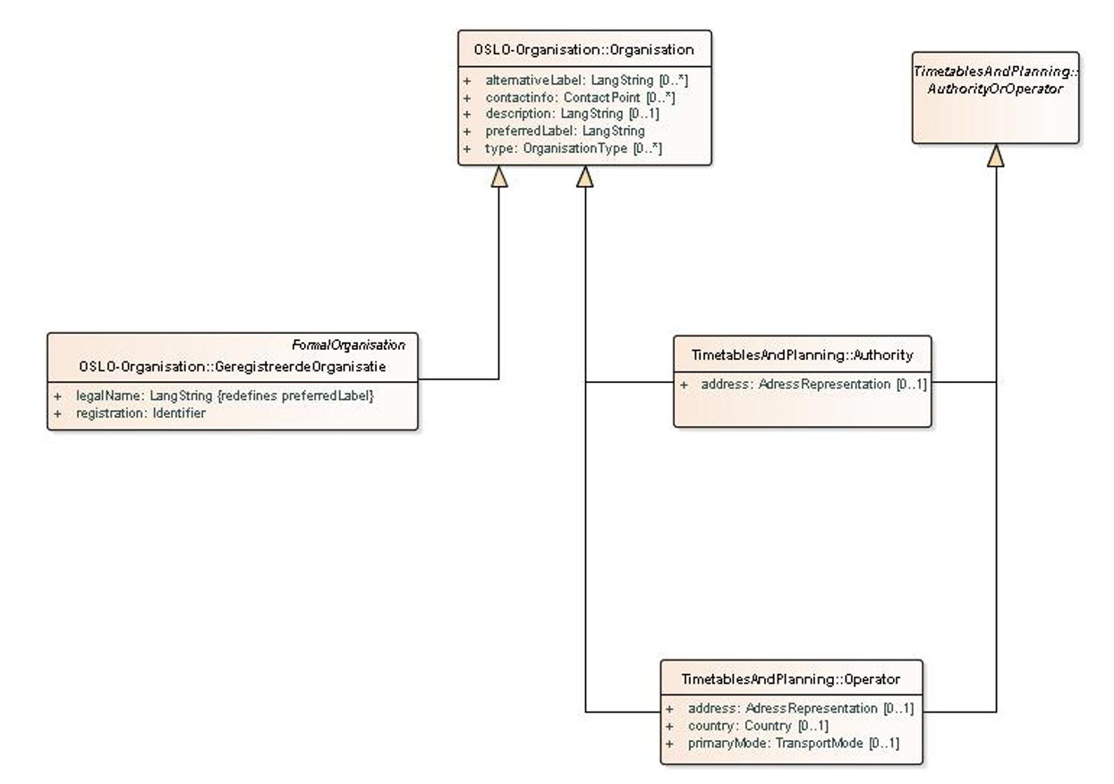
Example: OSLO Organisation

Slide 28
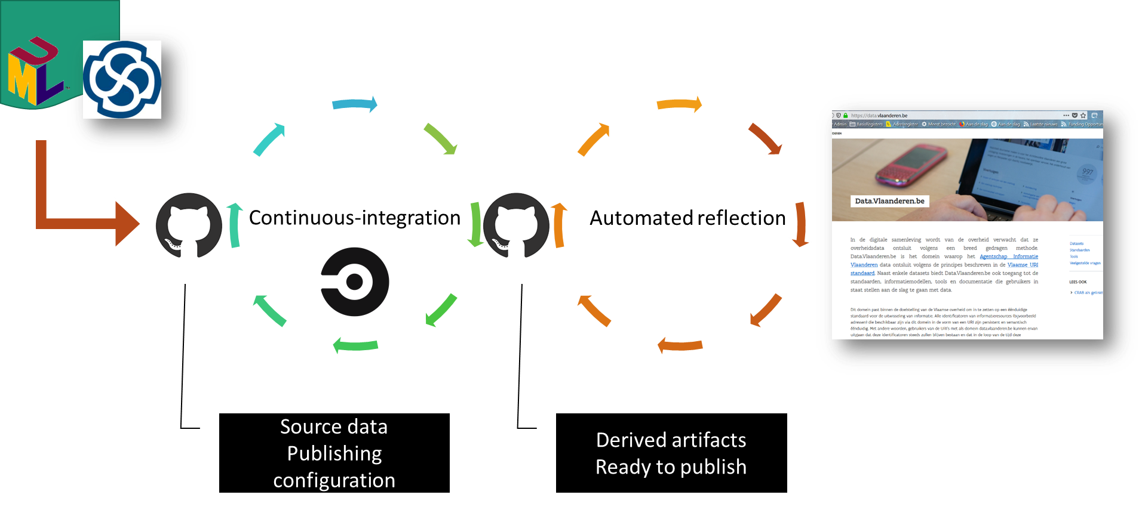
UML: Unified Modeling Language

Slide 29
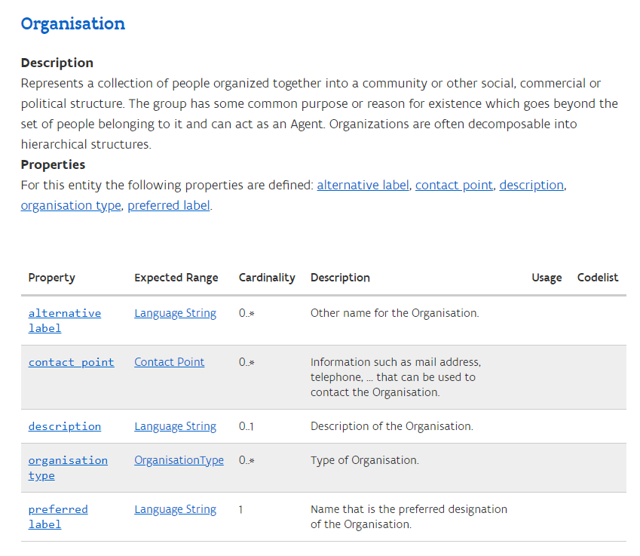
UML: Unified Modeling Language

Slide 30
Discussing the draft model
Digitaal Vlaanderen

Slide 31

WIP
Use case 1 – storyline
Before a consent can be given, we must clearly state who is the datasubject. The datasubject is the owner of the data and some identifying credentials of the owner should be defined.
DataSubject
The DataSubject can be a person or a legal entity.
We need identifying data like the name, national registry number, VAT code of the data subject…
The Receiver can be one person or a legal entity but it can also be a group of people with a specific credential. The same identifying data could be needed as for the DataSubject with a check of the credentials if needed.
Next to the datasubject, the receiver of the requested data should also be identified. A datasubject must always know who they are giving consent to access their personal data.
Receiver

Slide 32
WIP
Complete draft model

Slide 33
WIP
Interactive exercise
Does this model cover the relevant use cases?

Slide 34
WIP
Practical exercise: Are there any specific questions or comments? Are the use cases covered?
Mural

Slide 35

Are there other data standards, legislative documents and other references that are relevant within this exercise?

Slide 36
Q&A
Digitaal Vlaanderen

Slide 37
Why do we do ... ?
Wouldn’t it be better if we ... ?
Don’t we need to add ... ?
What about ... ?

Slide 38
Next steps
Digitaal Vlaanderen

Slide 39
Next steps
Processing all input from the business workshop.
Sending out the report from this working group. Feedback is certainly welcome!
Capture feedback via GitHub!
Publish first version of semantic model on GitHub. Feedback is certainly welcome here too!

Slide 40

Feedback
Feedback can be given via mail to the contacts below:
laurens.vercauteren@pwc.com
dimi.schepers@gmail.com
michael.geamanu@pwc.com
Feedback can be given via GitHub on the link below:

Slide 41
Thematic workshop (OSLO)
Today
Next workshop
19th
Business
werkgroep
21th
Thematic
workshop 2
16th
Thematic
workshop 4
August
September
October
November
December
23th
Thematic workshop 1
18th
Thematic
workshop 3
23th
Start public
review
Don’t forget to register!
https://overheid.vlaanderen.be/opleiding/oslo-trapeze?_cldee=a2V2aW4uaGFsZXlkdEB2bGFhbmRlcmVuLmJl&recipientid=contact-6ce4a8517dd3e811a972000d3ab98582-989da9acbb4241e4829946d2e8a0e828&esid=a14015bf-09d4-eb11-bacc-000d3adccc13

Slide 42
Thank you!

